Slide 1
Cloud AuthoriZation Trainer (CAZT)
https://github.com/Coalfire-Research/cazt Rodney Beede

Slide 2



Test Cloud APIs
Simulator Tool
Hands-on Practice
Verify your cloud provider’s security.
Are they secure?
CAZT simulates cloud-vendor APIs.
Practice cloud vulnerabilities.
See the vulnerability impact.
Understand security tooling.
Images care of pickpik.com
Notes:
Black Hat Sound Bytes

Slide 3

Security Pitfalls of Cloud APIs
OWASP API Security Top 10 2023
API1: Broken Object Level Authorization
API2: Broken Authentication
API3: Broken Object Property Level Authorization
API4: Unrestricted Resource Consumption
API5: Broken Function Level Authorization
API6: Unrestricted Access to Sensitive Business Flows
API7: Server Side Request Forgery
API8: Security Misconfiguration
API9: Improper Inventory Management
API10: Unsafe Consumption of APIs
https://owasp.org/www-project-api-security/

Slide 4
Cloud Vendor Vulns
No exact number
Internally discovered vulns not published
Some publicly known sources:
“Google Cloud: Here are the six 'best' vulnerabilities security researchers found last year” (link – zdnet.com)
Blogs (https://github.com/hashishrajan/cloud-security-vulnerabilities)
10 in AWS
19 in Azure
1 in Google and 1 in Oracle
Azure – ~284 CVEs (link – mitre.org)
Google Cloud – 66+ (link – published by google.com)
AWS Security Bulletins – 48+ (link – published by amazon.com)
Notes:
These numbers do not mean one vendor better than another. Just shows vulns do exist.

Slide 5
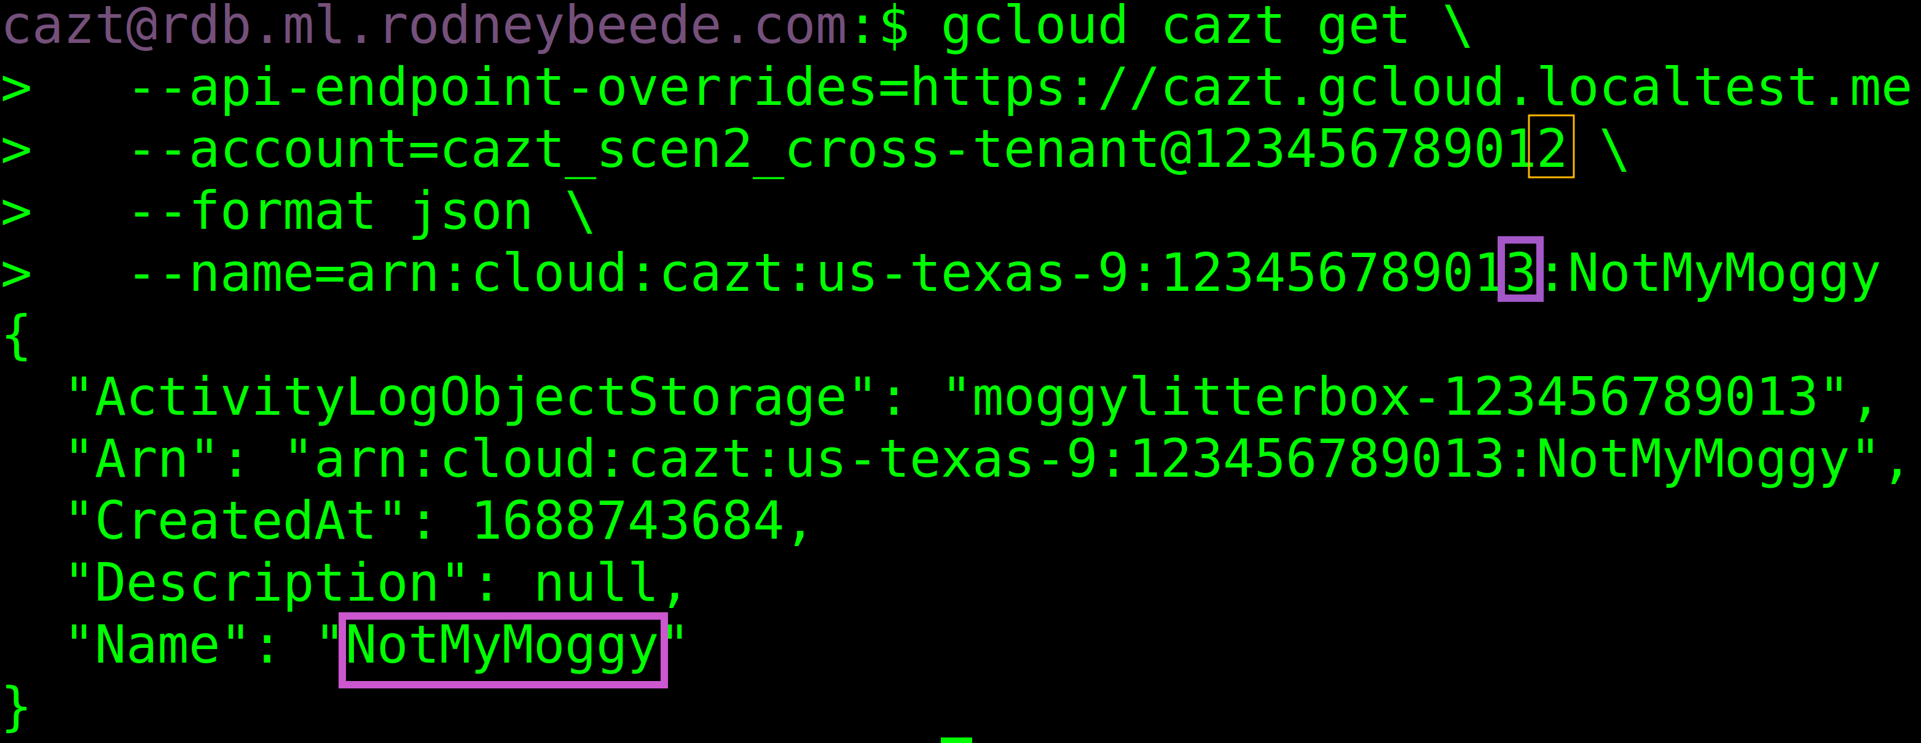

Slide 6
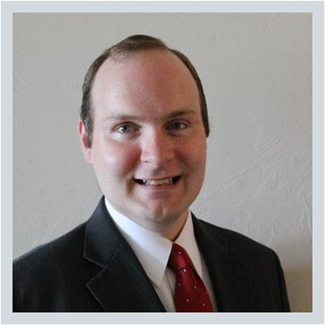
Rodney Beede
Education/certification
M.S. in Computer Science, University of Colorado
CISSP
AWS Security Specialty
OSCP
Biography
Rodney is a principal consultant for Coalfire and has specialized in cloud security for over 10 years. He has spoken at multiple conferences on topics from cloud security engineering to IoT device hacking. He has multiple CVEs for discovering web application security vulnerabilities. He started his career in enterprise web application software development but shifted to the security industry with this master's thesis research project "A Framework for Benevolent Computer Worms" 2012. He has held positions at RiskMetrics (MSCI), Cisco, HP, Seagate, Rackspace, and Coalfire.
https://www.rodneybeede.com/curriculum%20vitae/bio.html

